Slide 1
Fake News Detection
Team Members:
Aditya Chirania,181CO104
Anusha P. Das, 181CO108

Slide 2
Introduction
Fake news can cause considerable misunderstandings in society hence it is imperative to differentiate between Fake and True News.
This project utilises Machine Learning algorithms to perform the classification/prediction of news as Fake or True.
We will depict how good data cleaning techniques can impact the performance of the fake news classifier in this project.
We used text-preprocessing techniques like removing stop words, lemmatization, tokenization, and vectorization before we feed the data to models.
Fed data to various models and compared their performance. These data cleaning techniques fall under Natural Language Processing (NLP).

Slide 3
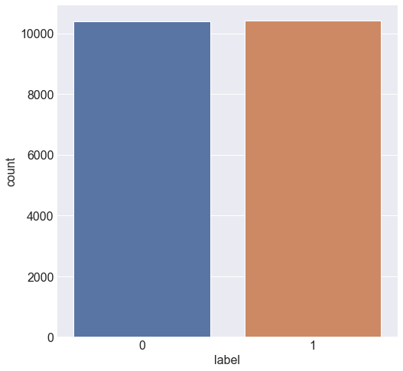
Examining the Dataset
The dataset, created by the University of Tennessee, USA is a collection of about 20800 news articles.
The attributes are:
id: unique id for a news article
title: the title of a news article
author: author of the news article
text: the text of the article; could be incomplete
label: a label that marks the article as potentially unreliable
1: Fake News or Unreliable
0: True News or reliable
The adjacent figure shows that the dataset is balanced with 10387 fake and 10413 true news.

Slide 4
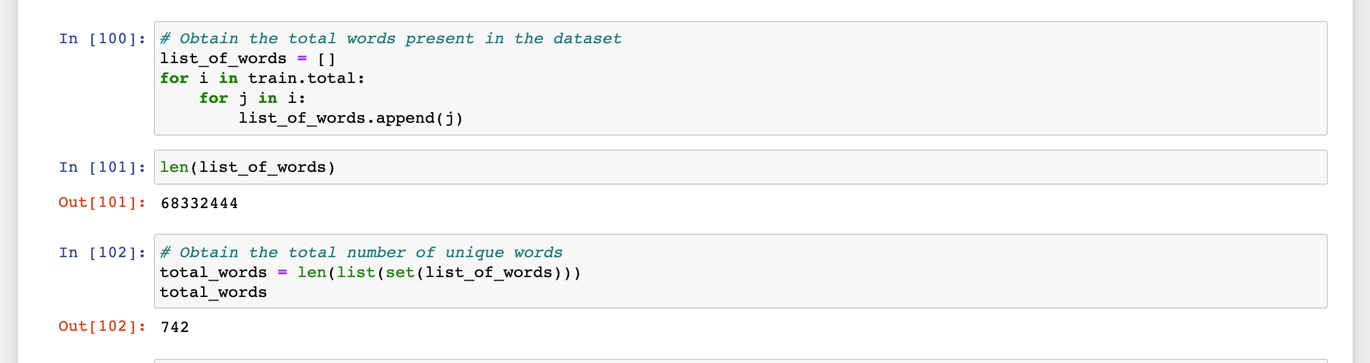
Examining the dataset (continued)
The below code snippet shows that:
Total Words | Total Unique Words
6,83,32,444 | 742

Slide 5
We broadly divide the working of this project into 4 parts:
Data Pre-processing & Cleaning
2. Feature Extraction
3. Applying various(11) Machine Learning models
4. Analyzing & comparing the results of the 2 approaches and finally conclusion

Slide 6
Data Pre-Processing
1. Missing Data Imputation
Datasets may have missing values, and this can cause problems for many Machine Learning algorithms. As such, it is good practice to identify and replace missing values for each column in the input data prior to modelling the prediction task.

Slide 7
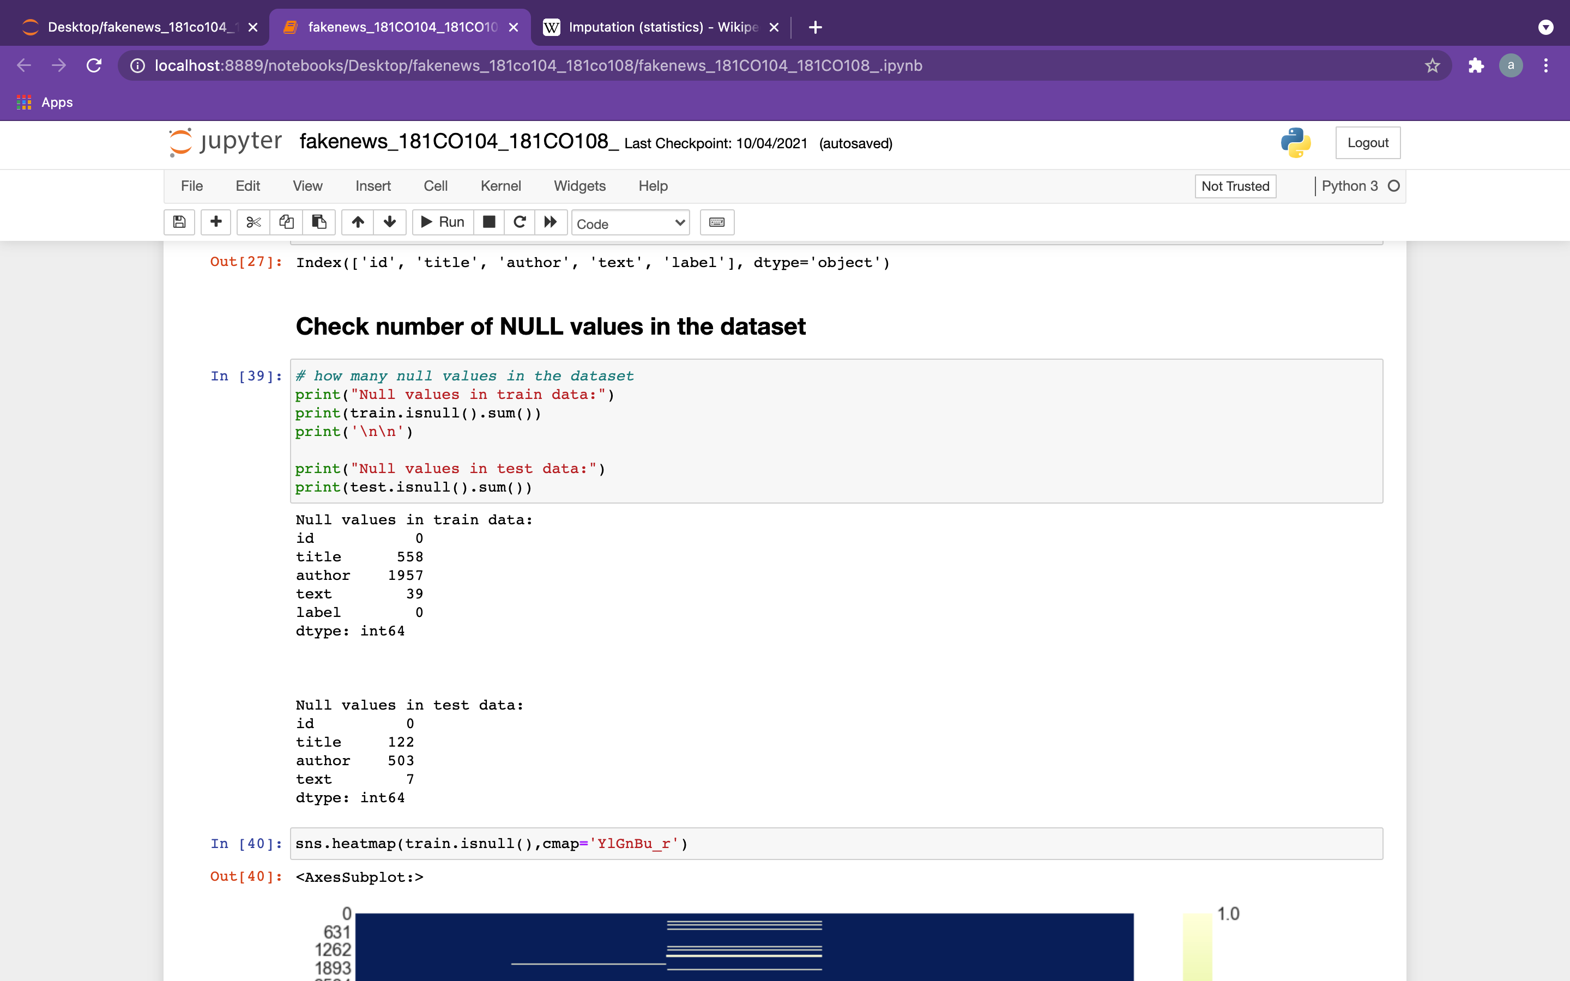
Why is Missing Data Imputation required?

Slide 8

Data Pre-Processing (continued)
2. Merging the attributes into one column for preprocessing the text

Slide 9
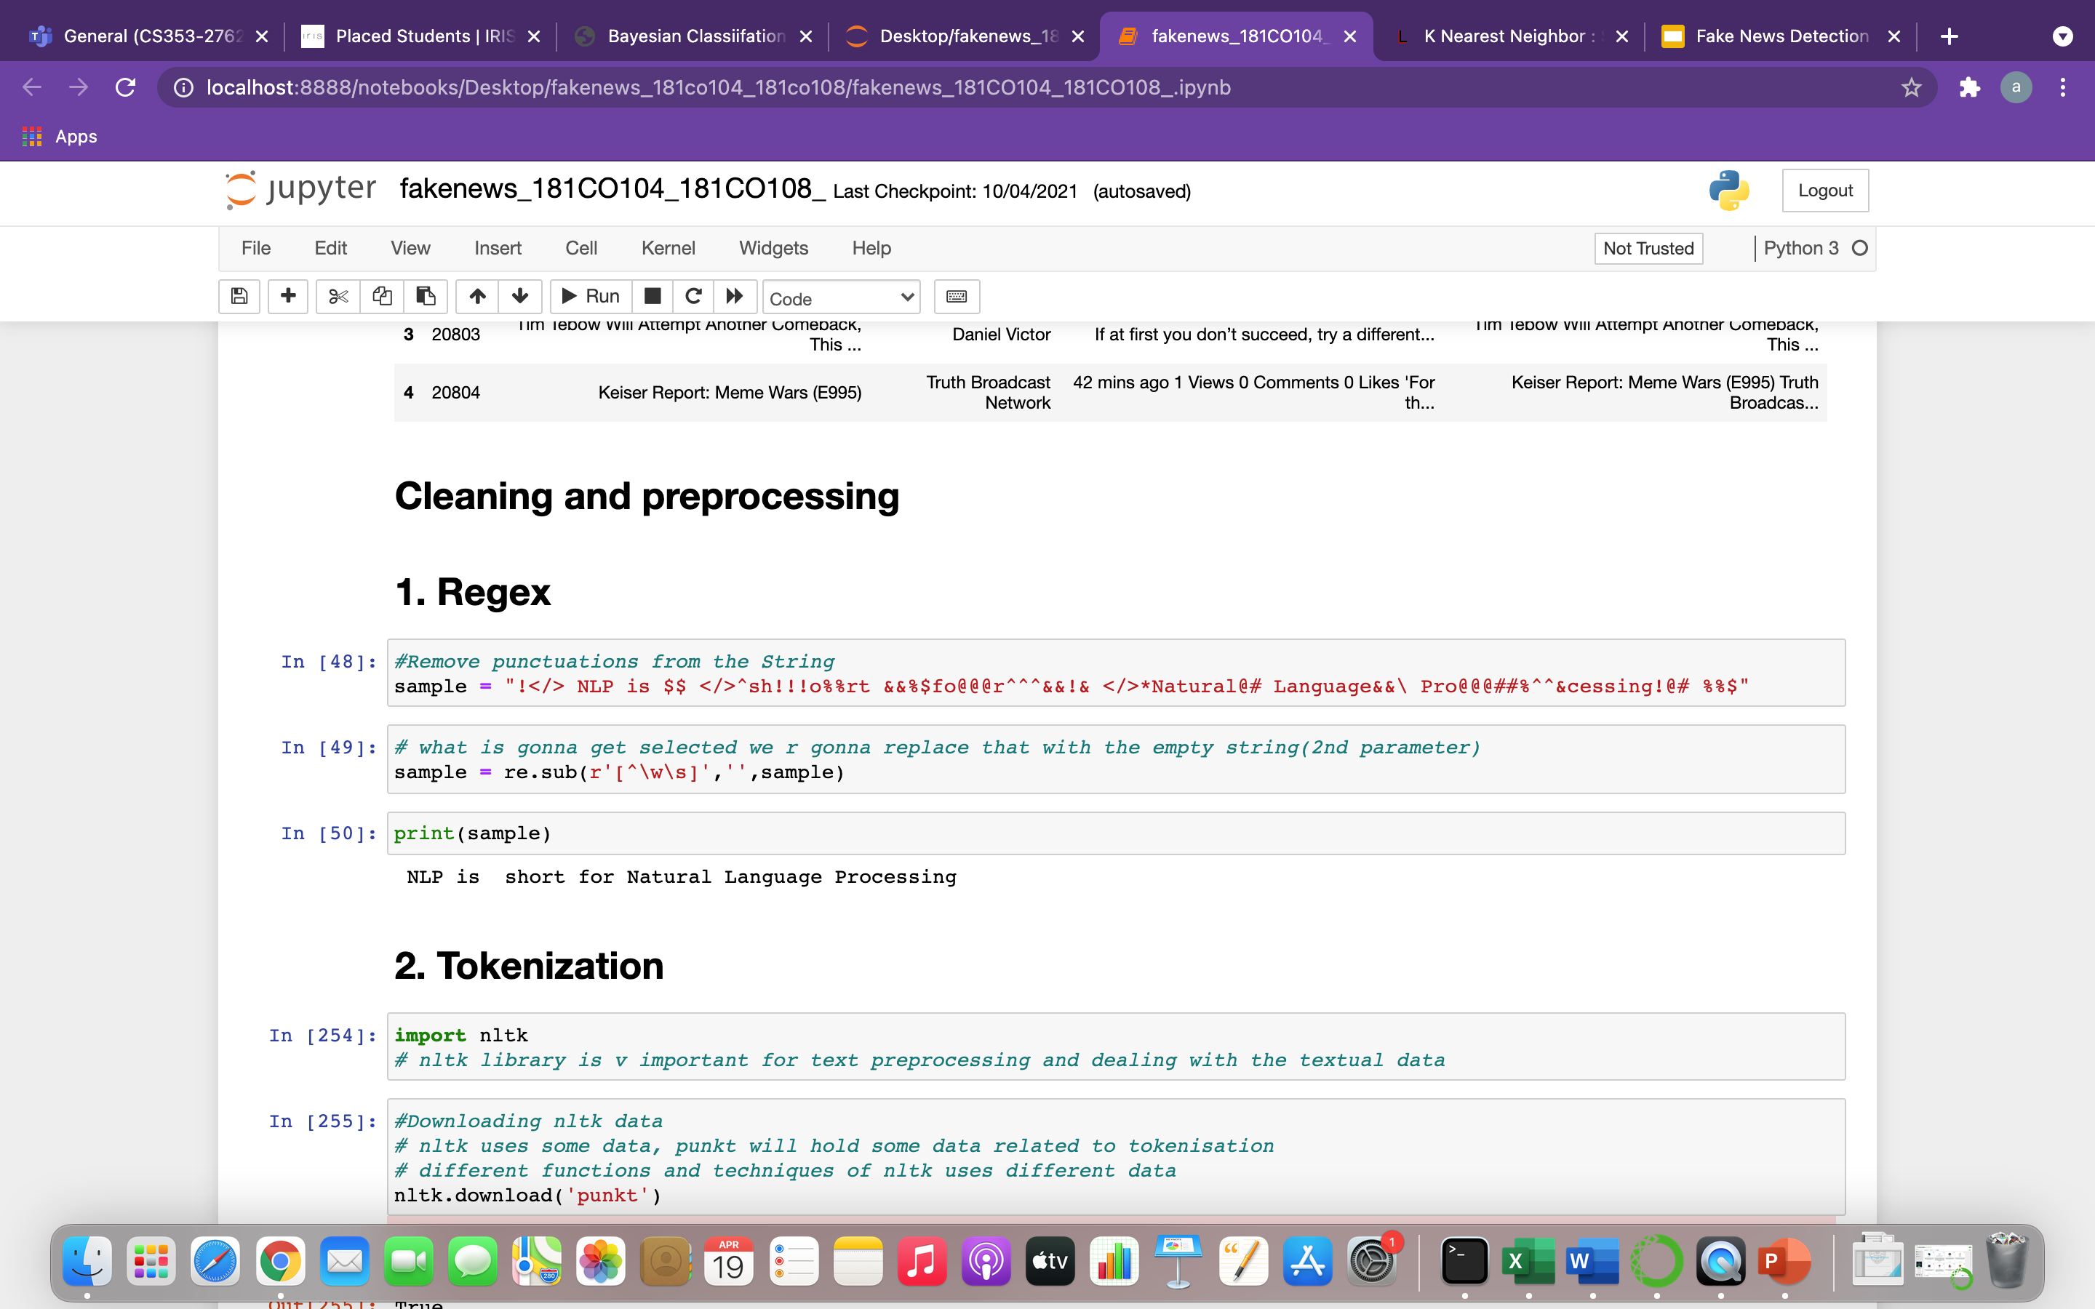
Data Pre-Processing (continued)
3. Using a Regex to remove special characters

Slide 10
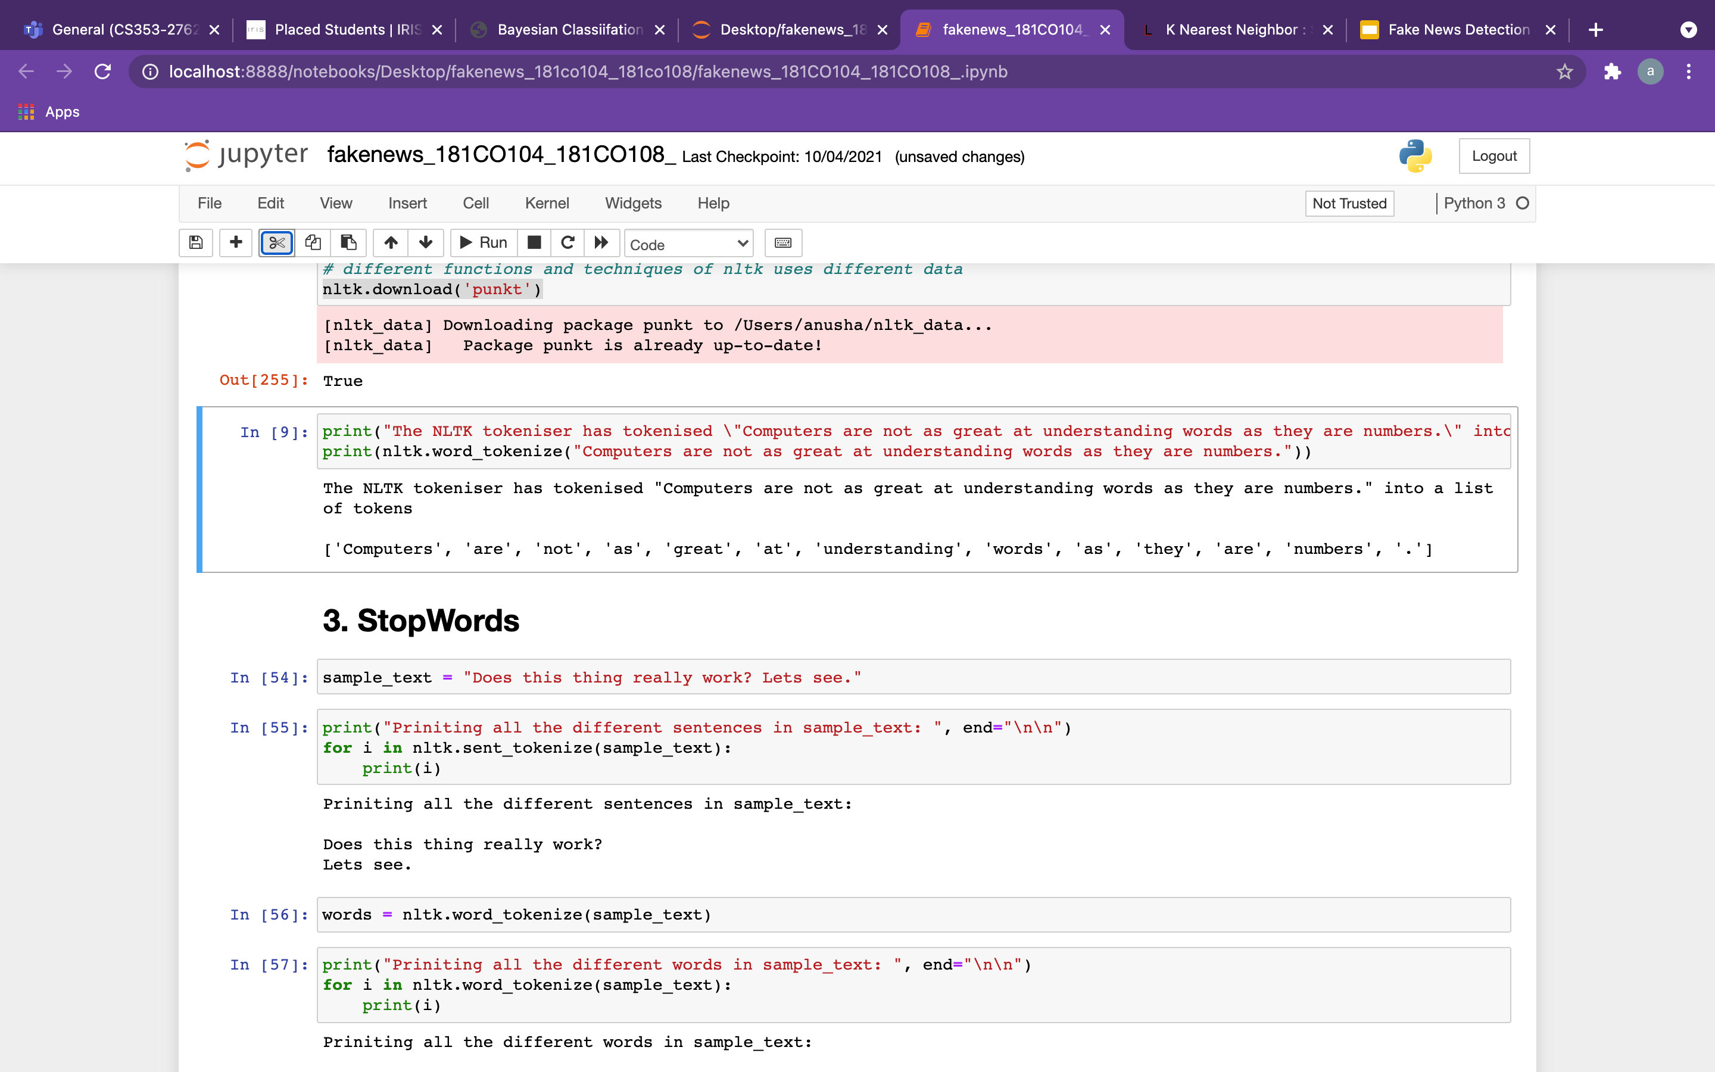
Data Pre-Processing (Continued)
4. Tokenization of Data

Slide 11
Data Pre-Processing (Continued)
5. Removal of stop-words
Before removing stop-words | After removing stop-words
Does this thing really work? Lets see. | ['thing', 'really', 'work', 'lets', 'see']

Slide 12
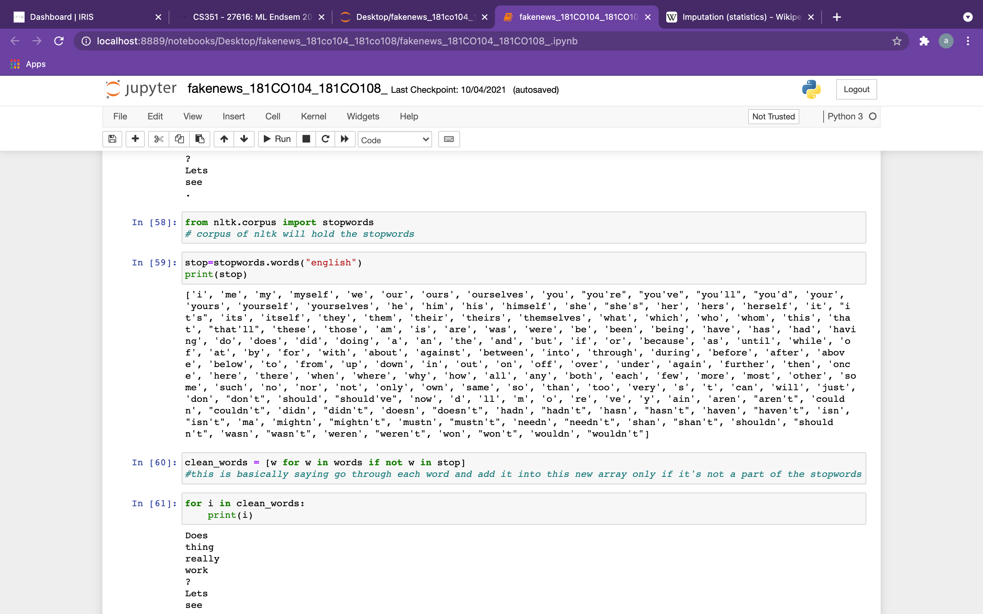
The list of stopwords available in the NLTK library are:

Slide 13
Data Pre-Processing (Continued)
6. Lemmatization
Before Lemmatization | After Lemmatization
kites | kite
babies | baby
languages | language
cities | city
mice | mouse

Slide 14
Data Pre-Processing (Continued)
7. Count Vectorization
Example: Sentence 1: "the sky is blue sky" Sentence 2: "the sun is bright sun" Feature set: ['blue', 'is', 'the’, 'sun’, 'bright', 'sky'] Resulting Matrix: [[1 1 1 0 0 2] [0 1 1 2 1 0]]

Slide 15
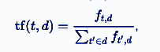
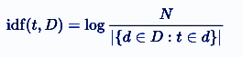
8. TF-IDF Transformation
Data Pre-Processing (Continued)
Term Frequency (TF)
Inverse Document Frequency (IDF)
TF-IDF Value = tf * idf

Slide 16
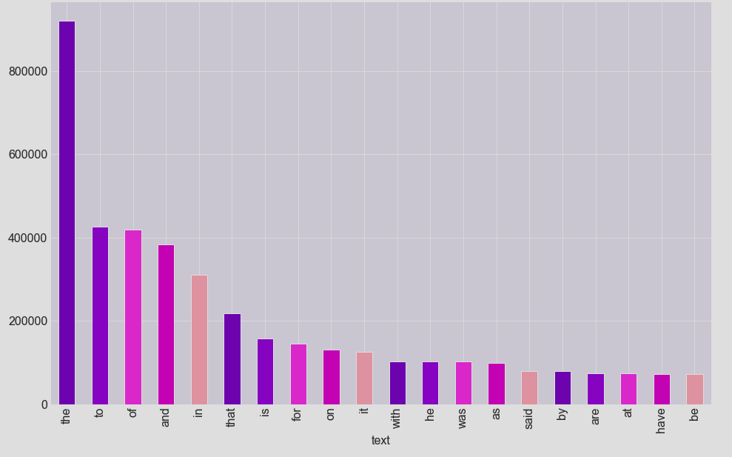
Top 20 unigrams before stop words removed
Stop words like “the”, ”to”, ”of”, ”and”, etc. are amongst the most frequent words present in the dataset

Slide 17
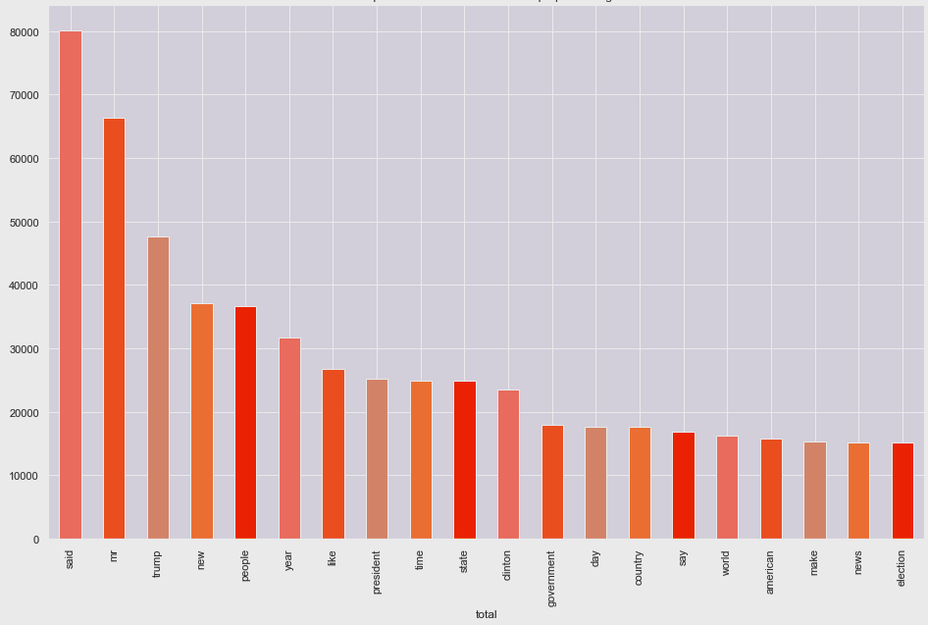
Top 20 Unigrams after stop words removal
Words like “said”, “mr”, “trump”, “new”, “people”,”year” etc are most frequent

Slide 18
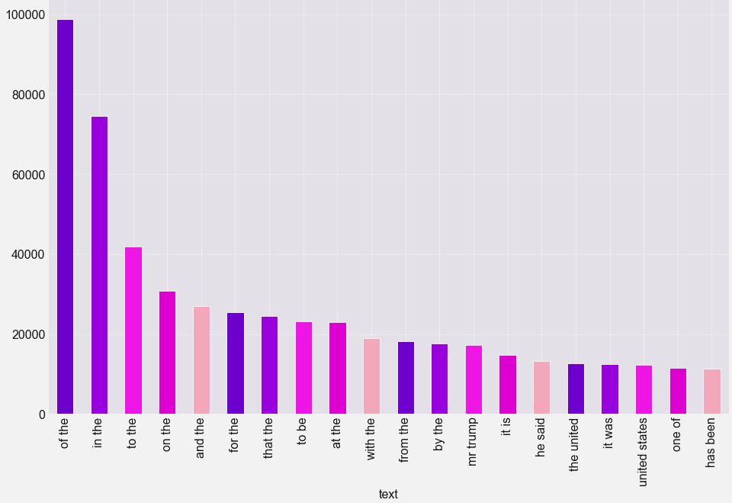
Top 20 bigrams before removing stop words

Slide 19
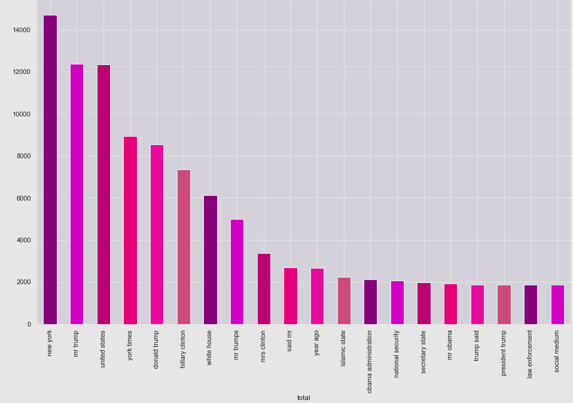
Top 20 bigrams after removing stop words

Slide 20
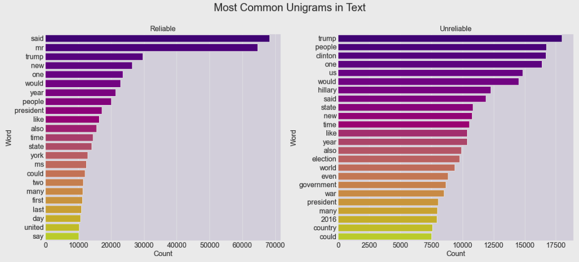

Slide 21
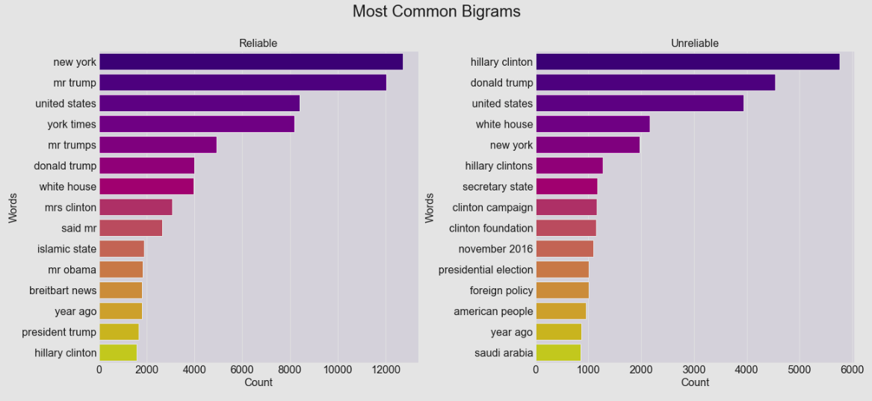

Slide 22
Models Applied
We have applied models with 2 approaches to data cleaning:
Approach 1: In the first approach, we have selected only one feature i.e the news text and have directly done TF-IDF vectorization after removing punctuation marks and eliminating rows with null values from the text.
Approach 2: In the second approach, we have followed the steps of removal of stop words, replacing null values with spaces, lemmatization, and combined all attributes including “author” , “text” and “title” into one column.
The difference of results from these approaches shall be indicating how important good NLP techniques are and how cleaning techniques like lemmatization and removal of stop words can impact the performance of models.

Slide 23
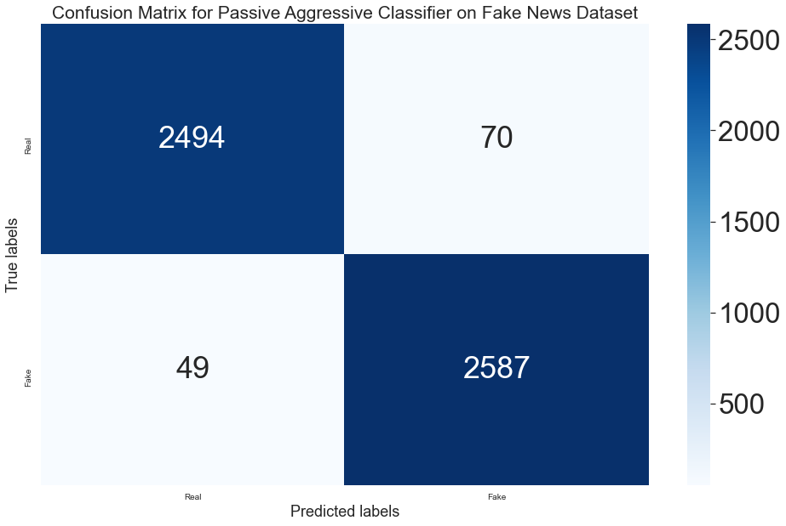
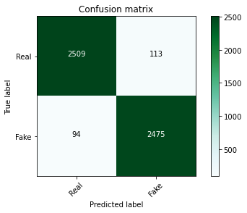
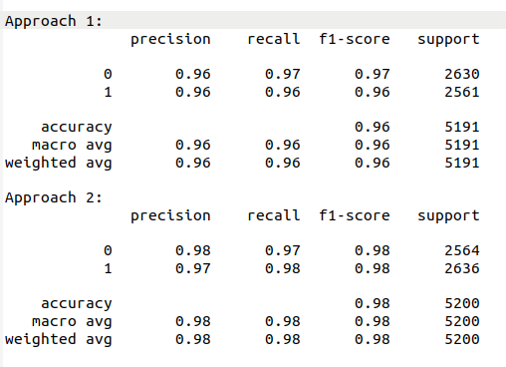
1. Passive Aggressive Classifier:

Slide 24
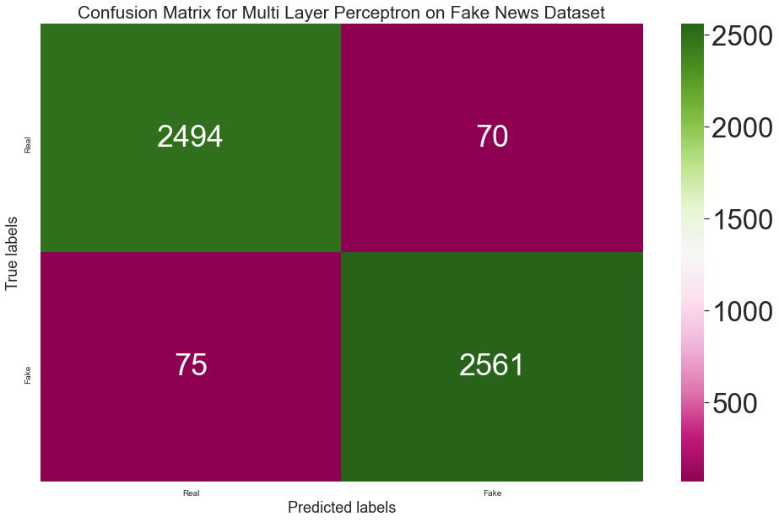

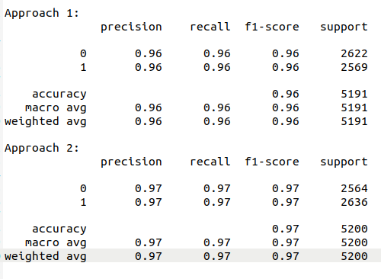
2. Multi Layer Perceptron

Slide 25
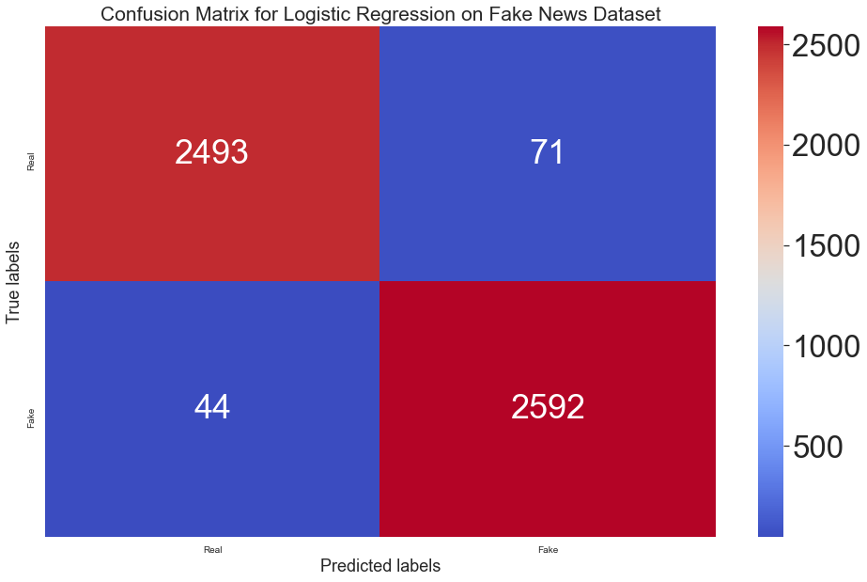
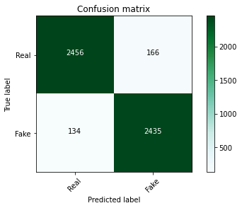
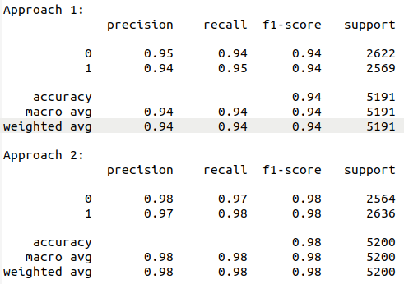
3. Logistic Regression

Slide 26
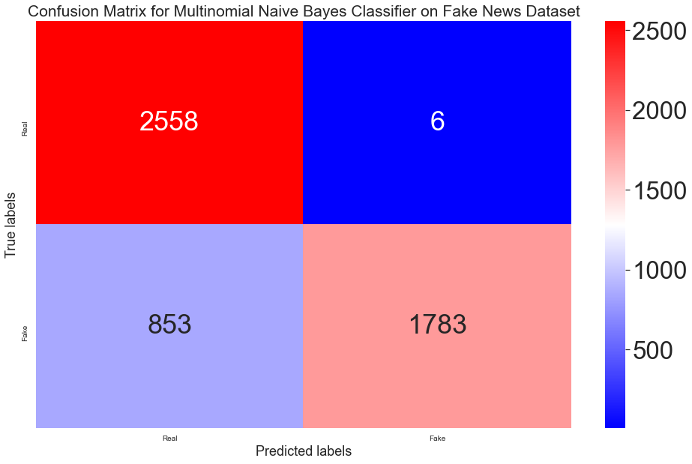
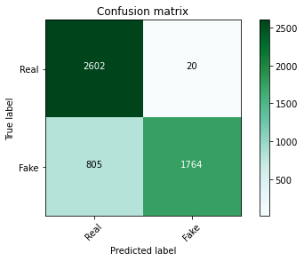
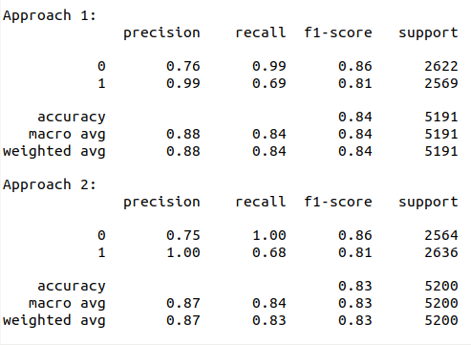
4. MultinomialNB

Slide 27
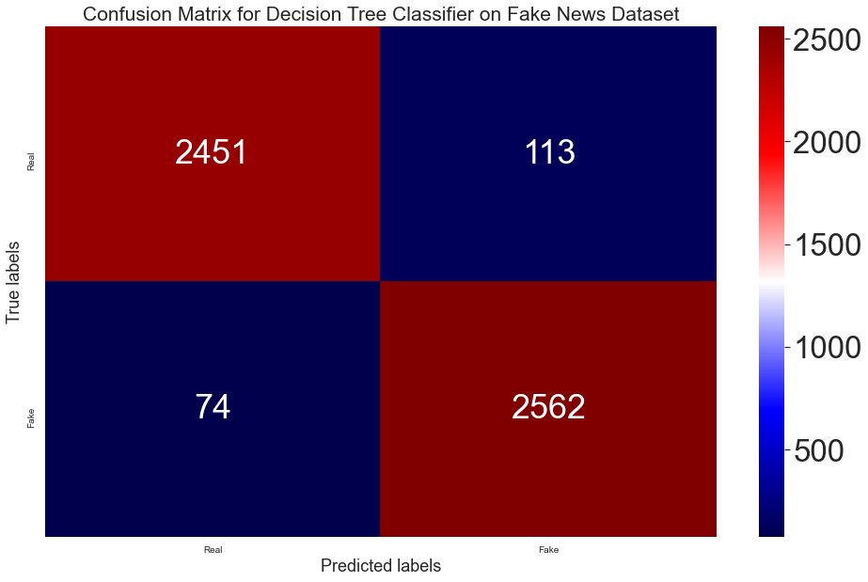
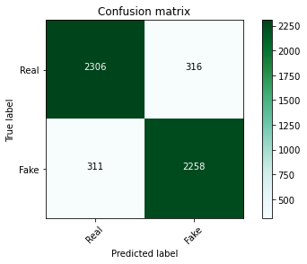
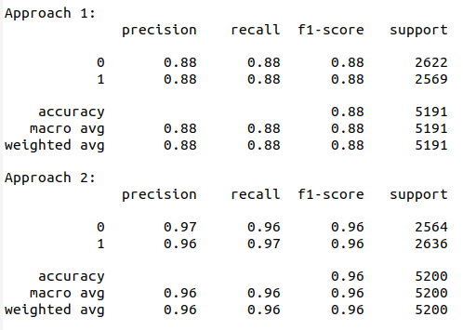
5. Decision Tree

Slide 28
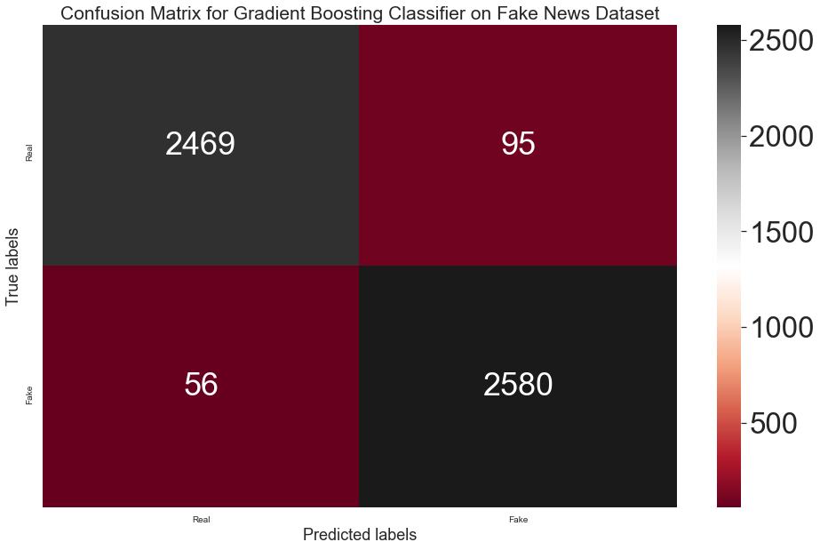
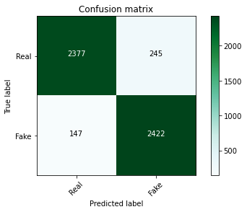
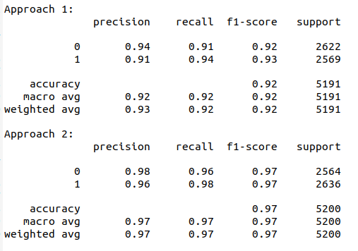
6. GradientBoostingClassifier

Slide 29
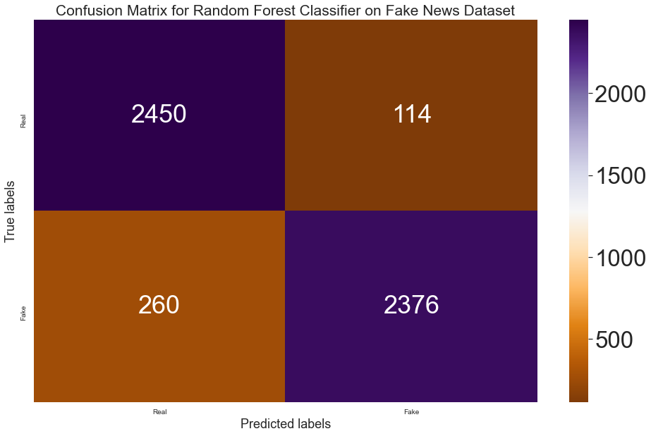
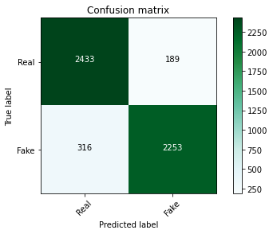
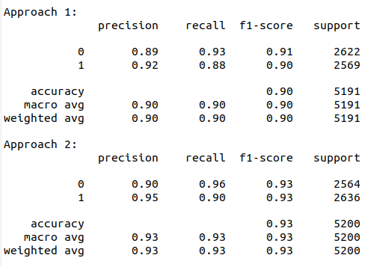
7. Random Forest Classifier

Slide 30
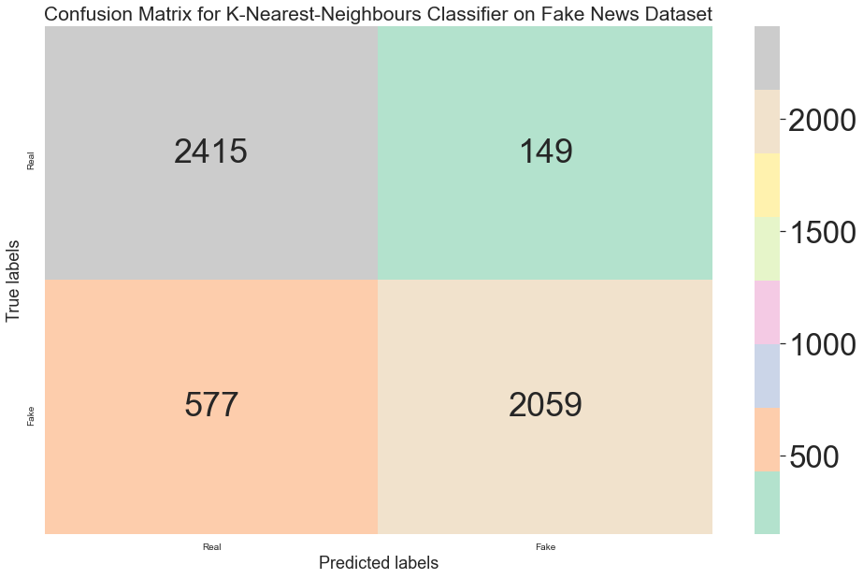
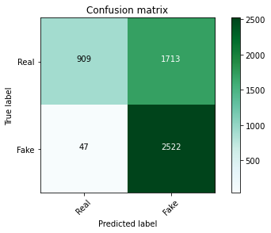
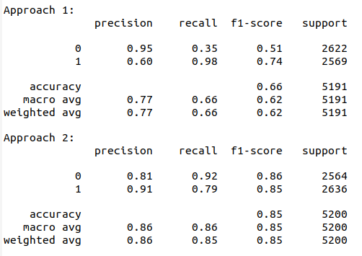
8. KNN

Slide 31
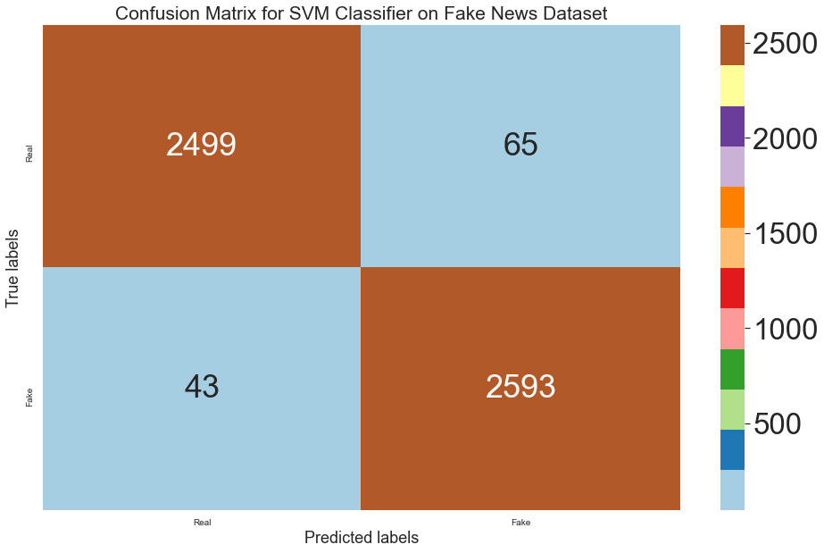

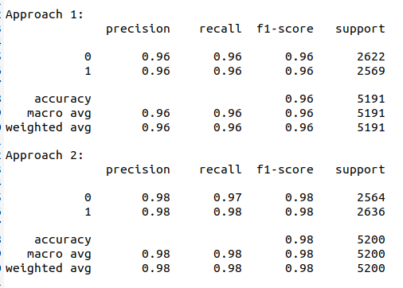
9. SVM-Linear Kernel

Slide 32
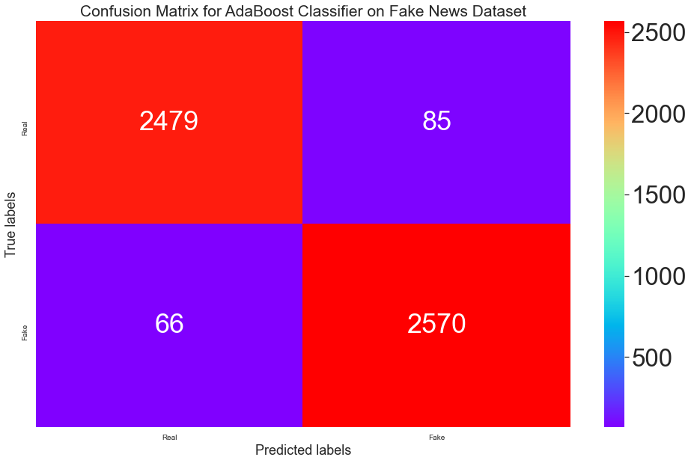

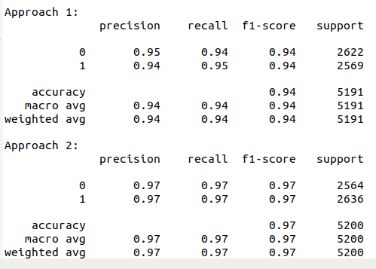
10. AdaBoost

Slide 33
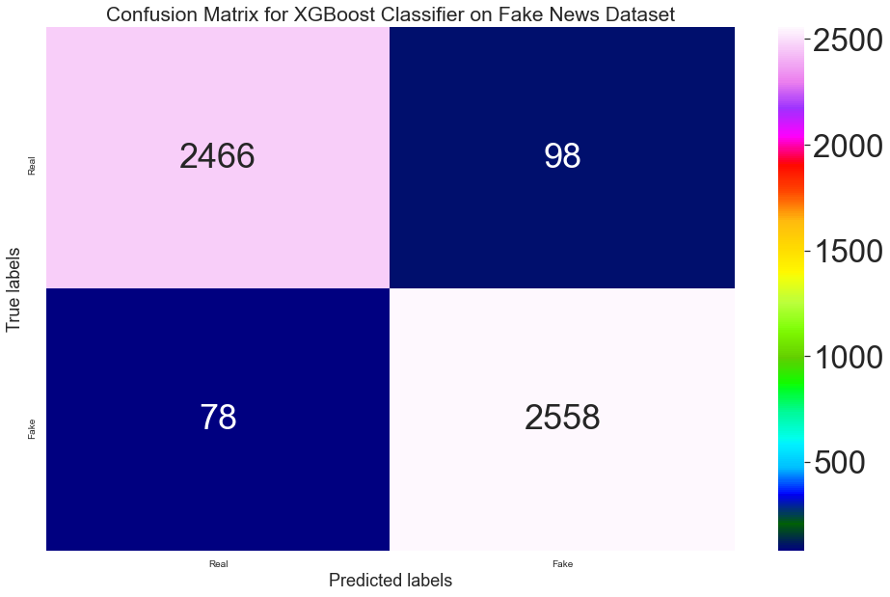
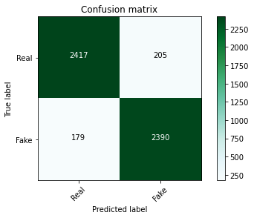
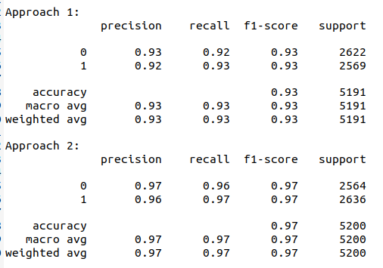
11. XGBoost

Slide 34
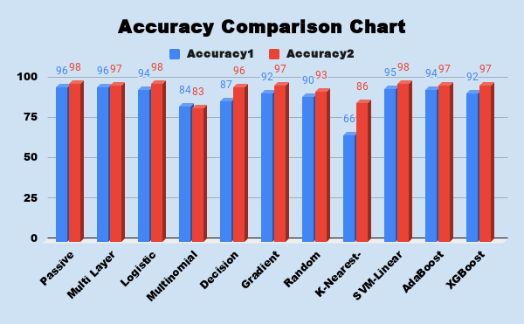

Slide 35
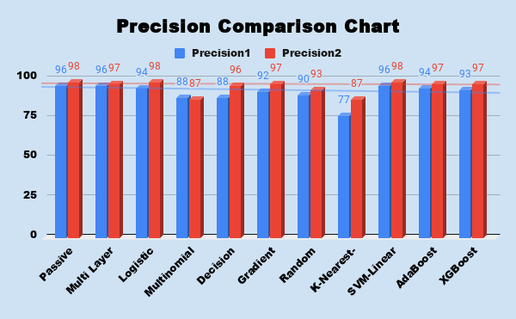

Slide 36
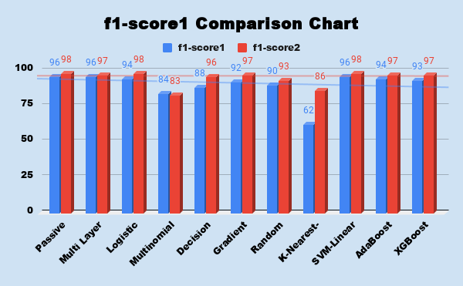

Slide 37
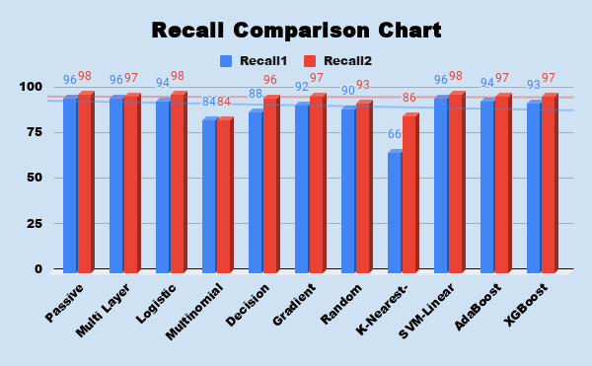

Slide 38
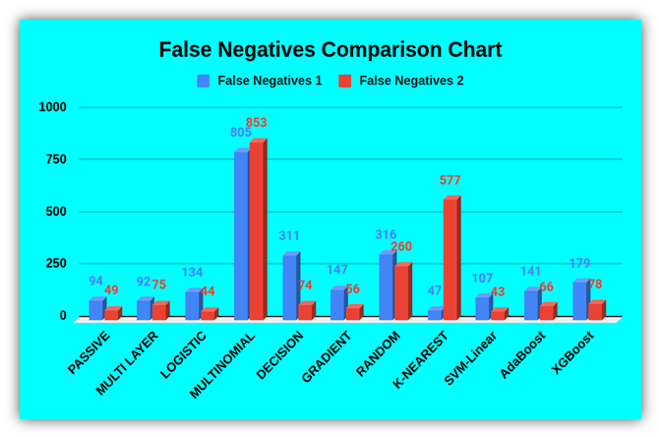

Slide 39
Conclusion
A Fake News Classifier should essentially ensure at least the following measure:
High accuracy
The number of False Negatives must be minimum.

Slide 40
We have made some concrete conclusions at the end of our experiments:
10 out of 11 models showed better accuracy, recall, precision and f1-score in the second approach. 9 out of 11 models showed lower number of false negatives in the second approach. This implies that processes like removal of stop words, lemmatization and inclusion of all attributes do significantly impact performance of a machine learning model of a fake news classifier.
We conclude that Passive Aggressive Classifier, Logistic Regression, Gradient Boosting Classifier, and SVM models show the best performance with respect to accuracy, recall, precision, f1-score and false negative values. They exhibit relatively higher values of accuracy with relatively lower values of false negatives. Hence, these models are better choices for the sake of fake news classification.

Slide 41
KNN scores an accuracy of 66% along with 47 false negatives as per the first approach. Despite increase in its accuracy in the second approach to 86%, it has very high number of false negative values which is clearly very undesirable. Hence KNN is not an apt model for fake news classification.
Multinomial Naive Bayes, with relatively lower accuracies of 84% and 83% in the first and second approach respectively, have significantly high false negative values of 805 and 853. Hence Multinomial Naive Bayes is not an apt model for fake news classification.

Slide 42
Thank You

